Slide 1
The Universe is Mine! Building apps that run on all Windows 8.1+ devices
David Underhill
Software Developer
TechSmith Corp
Presentation is on Github: https://github.com/underhilld2/OneDevDayDetroit2014
Email: underhilld2@gmail.com
Twitter: @DavidUnderhill3
https://github.com/underhilld2
http://blog.davescybercave.com

Slide 2
About Me
Developer for TechSmith Corp aka the Snagit and Camtasia Studio guys
Almost 20 year of professional experience
Another 10+ years of writing code for fun starting in middle school on a TRS-80 Model II
Previous experience in everything from GW Basic to Cobol to C to Java on PC, Unix, and Mainframe.
Written code to both support business objectives and also as a business
Most recent projects on Windows Phone and Store 8.1

Slide 3
Agenda
About me
What is a Universal App and how to get started
API Documentation
Tools that can help
Anatomy of a Universal App
Platform Specific Code
Shared Code
Implementing Portable Class Libraries
Some ways to share code with WPF Desktop

Slide 4
Agenda
About me
What is a Universal App and how to get started
API Documentation
Tools that can help
Anatomy of a Universal App
Platform Specific Code
Shared Code
Implementing Portable Class Libraries
Some ways to share code with Desktop

Slide 5
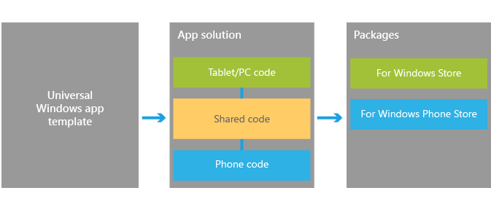
What is a Universal App
Notes:
Windows 10 convergence
This excites me the most about the coming years. I think MS kind of got lost when the released Vista and it flopped hard. Windows 7 and 8 were both steps getting us to 8.1. I really feel 8.1 is the major milestone to getting them back on track.
Currently Store and phone are supported and the roadmaps that have been talked about say that Xbox will also be in the list of packages you can create.
Develop once for all Windows devices using a unified Windows runtime and VS tools that allow you to both support experiences unique to a device in XAML, HTML, and DirectX, and share the code that supports those experiences across all devices using C++, C#, or JavaScript. When your work is finished you can you can produce the app packages that you will submit to the Windows Store and Windows Phone Store with a single action to get your app out to customers on any Windows device.
In terms of the Store experience, customers will benefit from an app identity shared across the Windows Store and the Windows Phone Store. Shared identity means that if they purchase your app from the Windows Store, they are capable of installing it on a device from the Windows Phone Store using the same Microsoft account without having to purchase the app again. Optionally, this can also include things like in-app purchases.
To get you started, the following sections will identify key upgrade paths, migration paths, and other critical resources that will help you bring your ideas to the converged Windows 8.1 platform. For more information on universal Windows apps and context on Microsoft’s vision for developer opportunity on Windows devices, please see our blog post Introducing universal Windows apps.

Slide 6
How to get setup to do store and phone development
https://dev.windows.com/en-us
https://devcenterbenefits.windows.com/
Notes:
https://dev.windows.com/en-us
https://devcenterbenefits.windows.com/

Slide 7
Agenda
About me
What is a Universal App and how to get started
API Documentation
Tools that can help
Anatomy of a Universal App
Platform Specific Code
Shared Code
Implementing Portable Class Libraries
Some ways to share code with Desktop

Slide 8
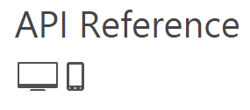
API Documentation
Minimum supported client | Windows 8 [Windows Store apps, desktop apps]
Minimum supported server | Windows Server 2012 [Windows Store apps, desktop apps]
Minimum supported phone | Windows Phone 8.1 [Windows Phone Silverlight 8.1 and Windows Runtime apps]
Namespace | Windows.Media.CaptureWindows::Media::Capture [C++]
Metadata | Windows.winmd
Capabilities | webcammicrophone
Notes:
Demo here show msdn page
Where are we with feature parity
What I have found is that we are really close on feature parity between universals 8.1 store and phone and then Silverlight 8.1 apps but not completely there.
http://msdn.microsoft.com/library/
http://msdn.microsoft.com/en-us/library/windows/apps/xaml/windows.media.capture.mediacapture.aspx
http://msdn.microsoft.com/en-us/library/windows.phone.media.capture.aspx
http://msdn.microsoft.com/en-us/library/windows/apps/xaml/windows.applicationmodel.package.aspx
Where are we with feature parity
What I have found is that we are really close on feature parity between universals 8.1 store and phone and then Silverlight 8.1 apps but not completely there.
http://msdn.microsoft.com/library/
http://msdn.microsoft.com/en-us/library/windows.phone.media.capture.aspx
http://msdn.microsoft.com/en-us/library/windows/apps/xaml/windows.applicationmodel.package.aspx

Slide 9
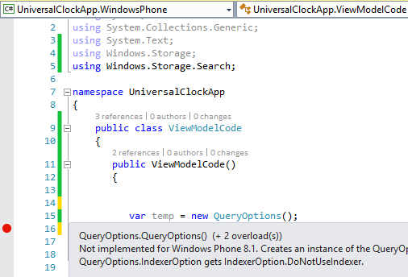
Another Thing to watch out for
#if WINDOWS_APP
var temp = new QueryOptions();
#endif
Notes:
Demo!
Be careful trusting intelisense. In store and phone apps there are cases where a class is valid for store but not phone and there is nothing in intelisense to warn you if phone is not supported.
Strongly agree here, it's confusing because you never know for sure when an API you use will blow up on either platform, unless you try it out (or read the docs, TBH). One of such examples is in Windows.Storage namespace:
KnownFolders.MediaServerDevices exists on both platforms, but using it in Windows Phone would blow up "unexpectedly".
On the other hand, ApplicationData.Current.LocalCacheFolder exists only on Windows Phone and you can't compile a Store project until you #ifdef it out.
Both APIs return a StorageFolder so it's not like they are completely different things. Hiding unsupported APIs would make this work much more transparently for developers...

Slide 10
Agenda
About me
What is a Universal App and how to get started
API Documentation
Tools that can help
Anatomy of a Universal App
Platform Specific Code
Shared Code
Implementing Portable Class Libraries
Some ways to share code with Desktop

Slide 11
Tools for Phone development
Visual Studio Performance and Diagnostics
Windows Phone Developer Power Tools (8.1)
Windows phone Power tools - http://wptools.codeplex.com/
Iso Store Spy - https://isostorespy.codeplex.com/
Project My Screen App -http://www.microsoft.com/en-us/download/details.aspx?id=42536

Slide 12
MVVM Libraries
MVVM Light
Prism
MvvmCross (Supports Xamarin)
Catel.MVVM
Caliburn.Micro
Notes:
MvvmCross supports Xamarin

Slide 13
Agenda
About me
What is a Universal App and how to get started
API Documentation
Tools that can help
Anatomy of a Universal App
Platform Specific Code
Shared Code
Implementing Portable Class Libraries
Some ways to share code with Desktop

Slide 14
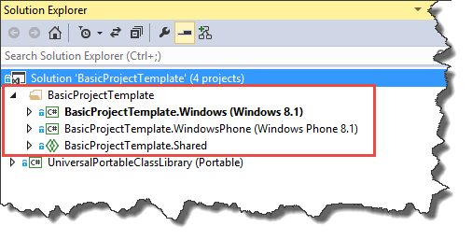
Anatomy of a Universal App

Slide 15
DEMO: Anatomy of Universal App

Slide 16
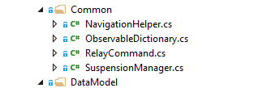
Helpers that come for free

Slide 17
DEMO: Platform Specific Code

Slide 18
DEMO: Shared Code

Slide 19
DEMO: Implementing Portable Class Libraries

Slide 20
Questions?

